Slide 1

Innovation and export performance: do young and old innovative firms differ?
 | This research has been co-financed by the European Union (European Social Fund - ESF) and Greek national funds through the Operational Program "Education and Lifelong Learning" of the National Strategic Reference Framework (NSRF) - Research Funding Program: ARCHIMEDES III. Investing in knowledge society through the European Social Fund.
Areti Gkypali^{1*}, Apostolos Rafailidis², and Kostas Tsekouras¹
¹ University of Patras, Department of EconomicsUniversity Campus Rio, 26504, Patras, Greece,
²Technological Educational Institute of Western Greece, Department of Business Administration Megalou Alexandrou 1, Koukouli 26334, Patras
R&D MANAGEMENT Conference 25th of June 2015

Slide 2
Agenda
Motivation
Theoretical Considerations
Hypotheses
Data & Method
Results & Discussion
Conclusions
Limitations and future research directions

Slide 3
Motivation
SSH
Export Performance
Innovation
Performance
Firm Life Cycle
LEH

Slide 4
Theoretical Considerations
The Self Selection Hypothesis (Wagner, 2007; SSH) and the Learning by Exporting Hypothesis (Clerides et al., 1998; LEH) claim different causality direction for the export-innovation nexus.
Constantini and Melitz (2008) devised a theoretical framework where they accounted for the existence of endogeneity between (in?) this relationship. However, it is implicitly assumed that (i) the differential gains of innovation activities are symmetrically distributed among innovators and (ii) export orientation is solely dependent on the productive performance gains induced by R&D activities.
Firms face different production possibilities sets, strategic priorities and constraints depending on the stage of their life cycle.
R&D capital is considered an input in the innovation process (Crepon et al., 1998) but it may also affect export performance (Harris and Moffat, 2011)

Slide 5
Hypotheses
H₁: Firms’ export and innovation performance present an endogenous two-way relationship
H₂: The endogenous relationship between innovation and export performance is moderated by firm’s age
H₃: Firm’s R&D capital indirectly and distinctively determines export performance in young and old firms

Slide 6
Coping with endogeneity and heterogeneity: Multi-group analysis
The structural relationships are quite complex and an appropriate methodology needs to be employed. Multi-group analysis is adopted in order to address simultaneous relationships and non-recursive models as well as control for firm level heterogeneity.

Slide 7
Why mutli-group modelling?
A threefold advantage of the adopted approach is that it allowed us to investigate
the existence of a feedback loop in the relationship between innovation and export performance,
the moderating effect of firm age, not only with respect to a key variable but also with respect to the overall model specification and which enables the examination of whether different groups behave similarly (Hayduk, 1987),
the indirect effect of firms’ R&D capital on export performance through its direct influence on innovation performance.

Slide 8
The model put differently…
The non-recursive system of equations is fitted by the robust full information maximum likelihood (MLR) estimator for continuous variables, accounting for missing data, heteroskedasticity and non-normality.
Standard errors are computed using the Huber-White sandwich estimator.

Slide 9
Data (1)
This research concerns Greek Manufacturing firms which all share a common attribute; that of presenting R&D activities either continuously or occasionally during the period 2001-2010.
The information employed in the present paper is the output of matching three different information sources:
GRD firms general and financial information through published financial accounts
GRD firms survey with unique information on R&D and exports
GRD firms knowledge stock construction via perpetual inventory method

Slide 10
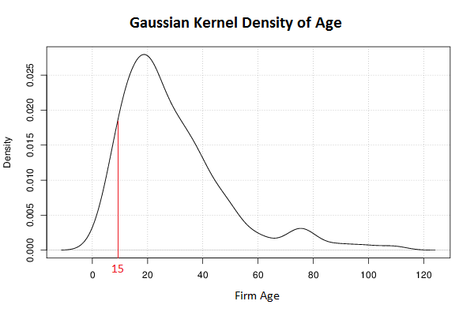
Data (2)
A central issue is the distinction between young and old firms.
Sample firms (N=300) exhibiting a right skewed distribution.
Age threshold at 15 years, for a good degree of representativeness of young firms (N_{y}=74), without increasing age threshold too far.

Slide 11
Results: Hypothesis 1
Existence of a feedback loop between innovation and exporting performance not confirmed.
Self Selection Hypothesis (SSH) supported by empirical results

Slide 12
Results: Hypothesis 2 (1)
Does firm age moderate the export-innovation nexus?
Multi-group analysis allows for testing for cross-group invariance by comparing two nested models: (1) a baseline model wherein no constraints were specified thus, across groups all structural parameters differ, and (2) a second model where critical structural parameters were constrained to be invariant between the two groups. Comparison by a Wald test imposing equality restrictions in structural parameters.

Slide 13
Results: Hypothesis 2 (2)
For young Greek Manufacturing R&D active firms empirical evidence supports the Learning by Exporting Hypothesis (LEH) while for old firms, the Self Selection Hypothesis (SSH) is confirmed.

Slide 14
Results: Hypothesis 3
In both groups, there is a statistically significant indirect influence of R&D capital on export performance, suggesting that the existence of an augmented knowledge base, reinforces the firms’ competencies and capabilities required to succeed in foreign market penetration.

Slide 15
Overall….
Empirical results do not corroborate a two way causality in the export-innovation nexus for the full sample of Greek R&D active Manufacturing firms.
Firms’ life cycle stage is hypothesized to convey the underlying heterogeneity due to different production possibility sets, strategic orientation etc. Hence we investigated the moderating role of firm age in order to reveal potentially differential patterns with respect to export-innovation performance relationship.
The direction of causality implied by the Learning by Exporting Hypothesis (LEH) is driving the Young Firms’ group while the Self Selection Hypothesis is supported by estimation results for the Old firms’ group.
R&D capital is a strong link for the relationship between innovation and export performance for both group of firms.

Slide 16
THANK YOU FOR YOUR ATTENTION!!!!!!

